Slide 1
Performance Evaluations
Notes:
Story on grades

Slide 2
Agenda
Overview
Details about design consultant evaluations
Evolution
Open discussion
Notes:
Focus is primarily on design consultant contracts.
Brent – Overview
Wendy – Details
Eric – stress the importance and talk about past evolution as well as future
Open discussion

Slide 3
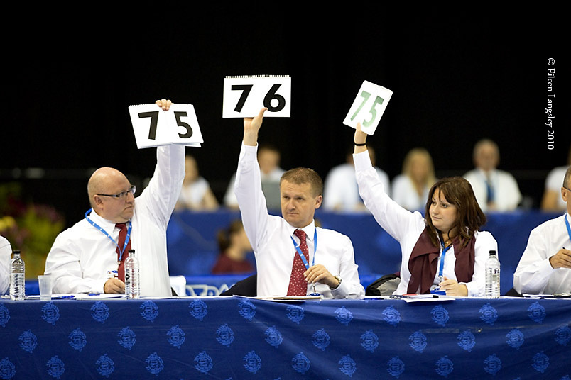
Why Measure Performance?
Create expectations
Communicate performance
Prompt feedback for improvement on subsequent phases
Feedback for future projects
Consider in selection of future projects
Notes:
Consultant improvement – different stages – have opportunity to hear from the customer
Future projects – provide insight to those on the selection committee on past performance

Slide 4
When?
Preliminary design complete
Final design complete
Final contract plans delivery
Selection/
project start
Design contracts
Notes:
Evaluations done at three stages.

Slide 5
Who does the evaluations?
Project manager
and
Location engineer
Individual Projects
Statewide Contract Letter Agreement
Varies
Notes:
Hear more later from Eric about move to a consistent, unified system for evals.
SW – at this point in time, evaluations of individual letter agreements vary. Contracts administered by Highway Design still have a spot for CO and DO.

Slide 6
What’s measured?
Technical ability
Schedule
Quality
Customer service/responsiveness
Working relationship
Scope & budget
Performance with project stakeholders
Notes:
Technical ability – screened by prequalification process
Quality – set of plans, traffic simulation model, environmental document, survey
Project stakeholders – public, elected officials, agency reps

Slide 7
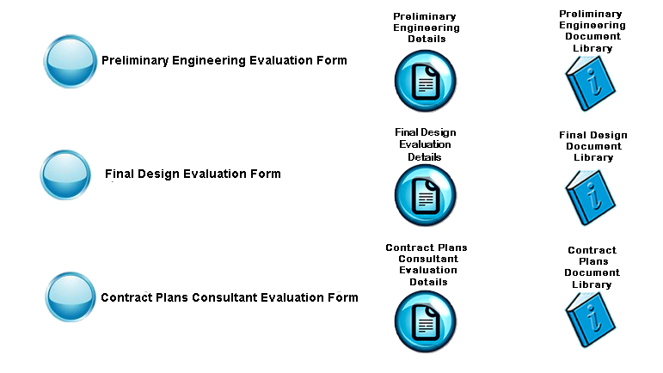
Notes:
Website - intranet

Slide 8
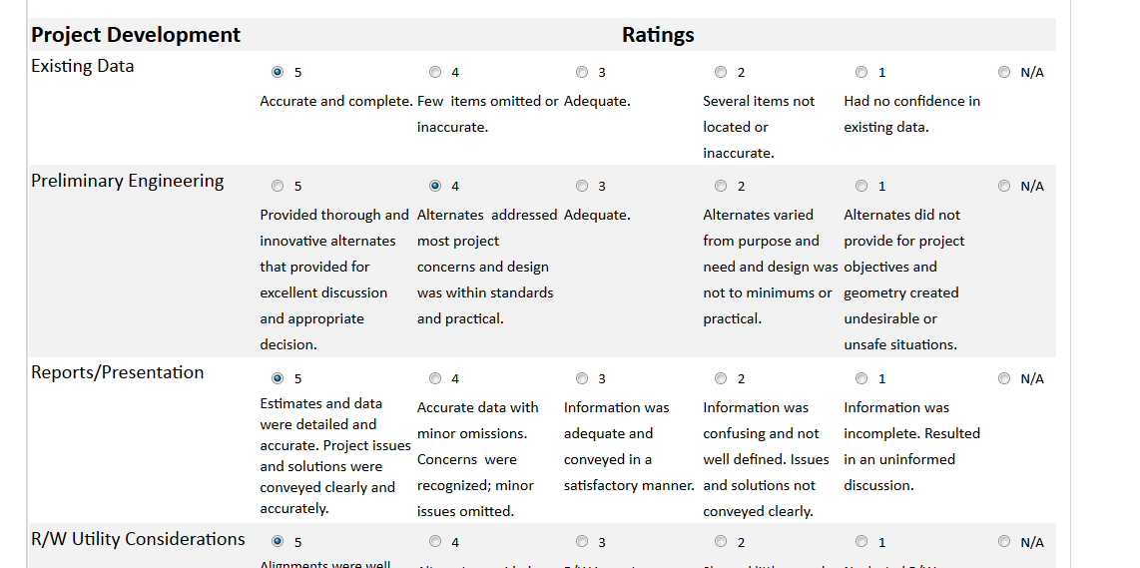
Notes:
Quick view of what an evaluator sees.

Slide 9
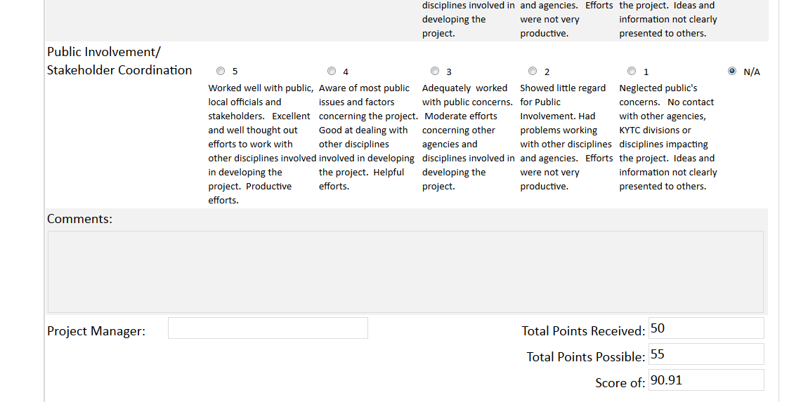
Notes:
If a category doesn’t get scored or receives a NA, the possible points doesn’t include that category either.

Slide 10
Notes:
All scores are put into a database. One for district office and one for central for each phase. The three scores are then averaged for a score for the job. All the jobs are then averaged together for a total score.
In 2010, changes were made to the scoring system, so there is a separation between the averages of scores before and after.

Slide 11
Consultant Evaluations Guidelines
www.transportation.ky.gov
Highway Design
Other Resources
Preliminary Final
Design Phase Contract Plans
Final Design Phase

Slide 12
Preliminary Design Phase

Slide 13
Preliminary Design Phase

Slide 14
Preliminary Design Phase

Slide 15
Preliminary Design Phase

Slide 16
Final Design Phase

Slide 17
Final Design Phase

Slide 18
Final Design Phase

Slide 19
Final Design Phase

Slide 20
Final Contract Plans

Slide 21
Final Contract Plans

Slide 22
Final Contract Plans

Slide 23
Final Contract Plans

Slide 24
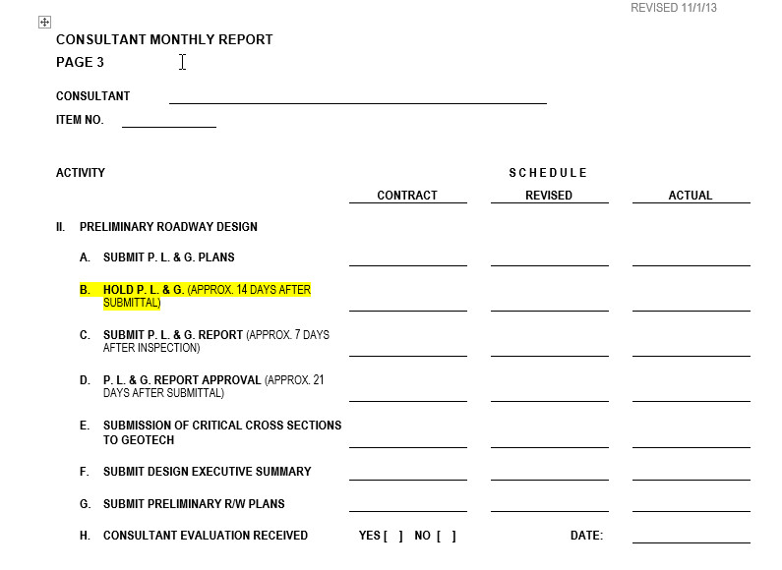
Consultant Expectations
Preliminary Design Phase Evals completed within 2 weeks after DES Approval
Final Design Phase Evals completed within 2 weeks after Joint Inspection Meeting Minutes Approval
Final Contract Plans Evals completed when Final Pay Estimate is received and approved by Highway Design

Slide 25
Consultant Expectations
Finding out a score
Questions concerning a score
Email: Brad.Eldridge@ky.gov

Slide 26
KYTC Project Managers and Location Engineers Expectations
Please utilize the “Comments” at bottom of Evaluation
“Consultant Evaluation Received” check box on Consultant Monthly Report
COMING SOON
Generated Report to list Projects that need evaluation
-Two weeks after approval of the Design Executive Summary
-Two weeks after Final Joint Inspection Meeting

Slide 27
Eric Pelfrey – Professional Services
Importance of Evaluations
Recent Improvements
Future Considerations
Audience Feedback
Notes:
Importance of Evaluations to:
Professional Services
KYTC’s Project Managers
Consultants
Feedback from:
Consultants
KYTC Project Managers

Slide 28
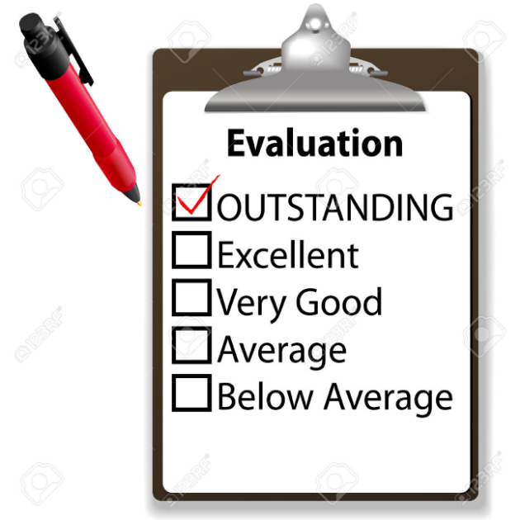
Importance of Evaluations
Consultant Selection
Record of Past Performance (Page 6)
23% of total points
List scores or quote
PMBC / PMBCX
Restore confidence for selections
Clear expectations
Notes:
Committee scores Record of Past Performance based on Similar Projects (Page 6)
15 points or more of 66 total points
Selection Committee members need to comprehend success
List score or quote KYTC’s PM or a local elected official
Bootcamp – Successful project manager training that will pay long-term dividends
PMBC – 3 sessions of 75 graduates, 1 upcoming in Spring
Many commented evaluations needs to better serve selections
PMBCX - 5 sessions for 175 graduates, 2 more planned in Fall with 65 enrolled
Consistent theme was need for clear expectations

Slide 29
Three Kinds of Feedback
Evaluations – Ratings based on Criteria
Relative ranking versus other firms
Coaching – Improve Performance
Learn tendencies of PMs
Acceptance – Approval by KYTC’s PM
Increased potential for reselection
Notes:
If any firms are satisfied with their workload, please feel free to ignore the remainder
Through “coaching” you can learn tendencies of PMs and limit future mistakes
By gaining “acceptance” your higher scores will result in reselection, both in that District and statewide

Slide 30
Recent Improvements
Highway Design’s current database is on Intranet
Consultant evaluation criteria is on Internet
Statewide Letter Agreement evaluations
Planning, Environmental, Right of Way, HSIP,
Geotechnical Services, Pavement Rehab
Contract Manager provides evaluations
Notes:
Wendy
Remaining User Divisions are anticipated to develop similar evaluations
Potential to add an Evaluation by District PM

Slide 31
Future Considerations
Evaluations maintained by Professional Services
Negotiation Compliance
Excessive Contract Modifications
New database fields
Date of Evaluation
SYP Project Type
Consultant PM
Notes:
New Database fields to better serve Selection Committees
Filter only by pertinent information and extract projects that may not apply

Slide 32
Future Considerations
Standardized Consultant Evaluation form
Project Milestone Evaluation Notifications
Require comments if above/below satisfactory
Abbreviated Annual Evaluations
Consistently communicate performance
Alleviate omissions & oversight by turnover
Notes:
Develop a standard form regardless of User Division, for consistency and comprehension
Wendy
Open the communication dialogue between PM/consultant
Alleviate burden on new PMs after previous PM moves on

Slide 33
Future Considerations
Independent Subconsultant Evaluations
Significant amount of varying services
Evaluations by PM and SME
Evaluator-Based Scoring Analysis
Equitable, consistent scoring
Restore Selection Committee’s confidence
Notes:
Current consultant evaluation average is 95%
Normalize evaluations based on KYTC’s evaluator
Restore faith rather than penalizing a firm for a low outlier

Slide 34
Future Considerations
Plan Processing Evaluations
Plan Quality
Revisions
Accounting Controls Evaluation
Accurate Invoice submittal
Personnel Utilization
Notes:
Plan Processing to evaluate directly
Post-audit may help determine whether an appropriate budget was scoped and classifications utilized

Slide 35
Feedback / Open Discussion
Highlights of the current system
Concerns of any future considerations
Additional suggestions for changes
Other ways to add value for KYTC
Define expectations and communicate feedback
Notes:
Any written questions?
Other topics for discussion?

